Slide 1
Who is Alejandro Brittes?
And what is Chamamé?

Slide 2
Alejandro Brittes
Alejandro Brittes, a Brazil-based Argentine composer, accordionist, and author delves into his chamamé heritage, a rhythmic connection to the Earth and the Universe. The music blends Indigenous Guaraní musicality and Baroque influences from Jesuit missions in a cultural region spanning parts of Argentina, Brazil, Paraguay and Uruguay.

Slide 3
Alejandro Brittes
Featured at the Library of Congress on his 2023 East Coast tour, Brittes will be touring the West in 2024, performing at venues such as: San José Jazz Festival, Stanford Live, Tucson Meet Yourself, and Albuquerque Folk Festival . The trio consists of Alejandro Brittes, André Ely, and Carlos de Césaro. This 2024 tour is a realization of the Ministério da Cultura Brasil - Governo Federal - União with sponsorship of Arroz Prato Fino, through the Lei de Incentivo à Cultura - Rouanet.

Slide 4
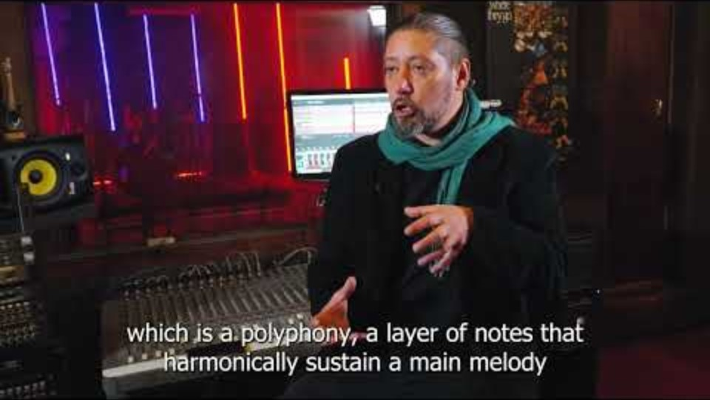
What is Chamamé?

Slide 5

ALEJANDRO BRITTES TRIO

Slide 6

Free Concert
Join us on Wednesday, September 4th
^{5:00 to 7:00 pm (PDT)}
Book Talk & Concert in Theater 37.
This exciting event is free and open to the public.

